Slide 1

IMS PRESENTATION();
Conor White

Slide 2
Who am i?
Trainee Software Developer.
Previous experience.
approach
Planned diagrams
Jira
Github
DATABASES
Code
Test

Slide 3
Technologies learnt
JIRA
GIT
GITHUB
JAVA
MAVEN
JUNIT
MOCKITO

Slide 4


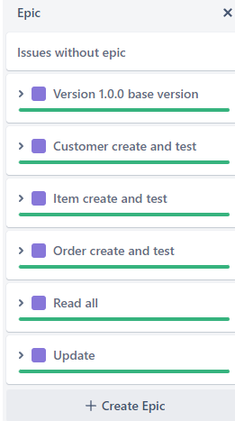
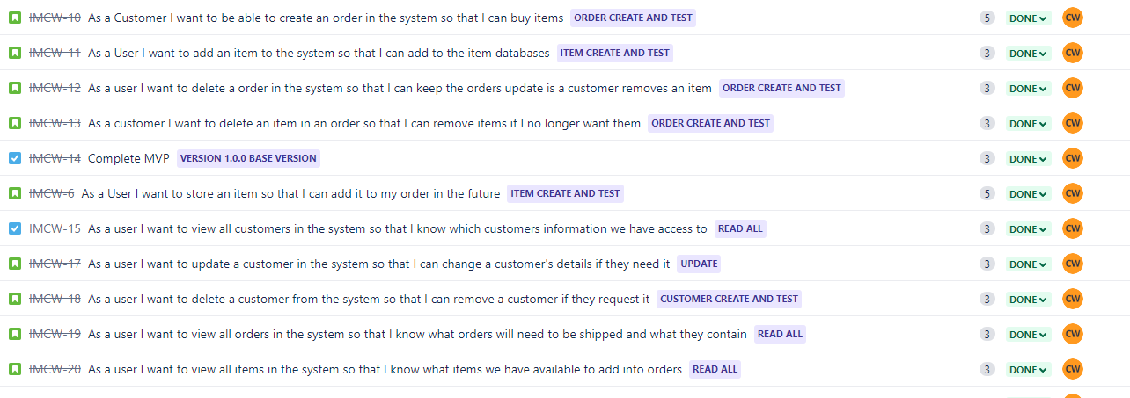
Jira

Slide 5

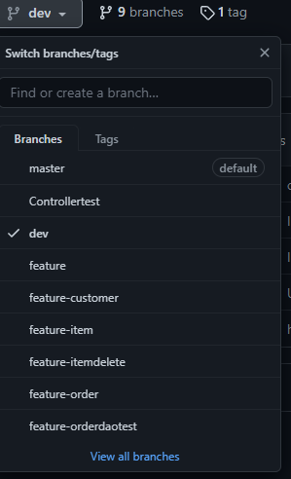
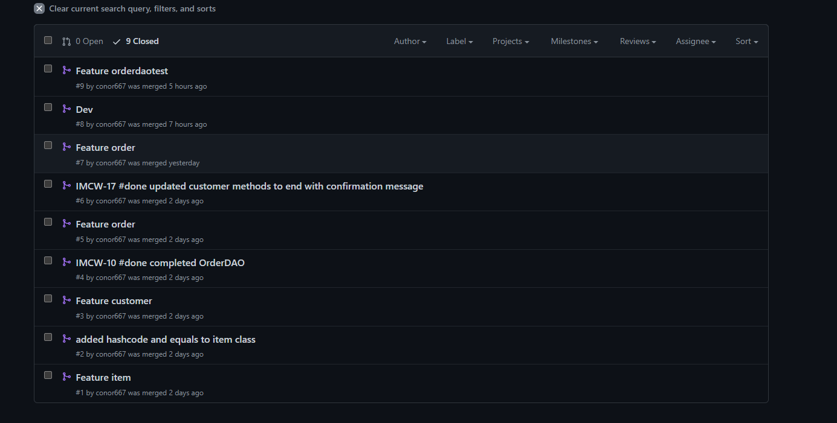
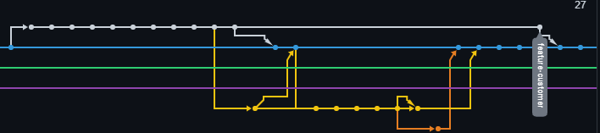
Version control : GIT

Slide 6
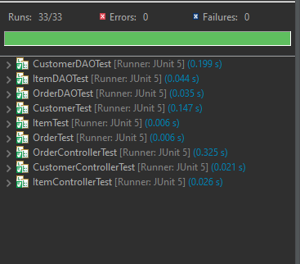
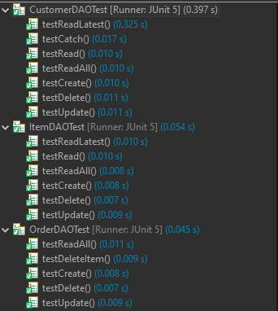
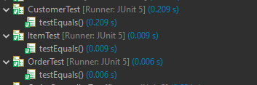
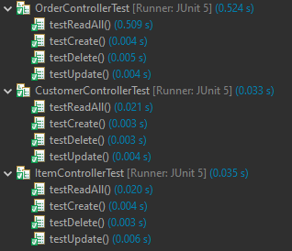
TESTING

Slide 7
DEMONSTRATION

Slide 8
SPRINT REVIEW
COMPLETED:
MVP (CRUD FUNCTIONALITIES ARE INCLUDED)
TESTING (ALL MAJOR FUNCTIONS ARE TESTED)
JIRA (USED JIRA TO TRACK USER STORIES AND GIT TO SMART COMMIT)
GITHUB (USED GITHUB EFFECTIVELY TO CONTROL BRANCHES AND PULL REQUESTS)

Slide 9
SPRINT REVIEW
WHAT WOULD I LIKE TO IMPROVE:
CLEANER CODE
MORE FUNCTIONALITY
BETTER DESIGN

Slide 10
SPRINT RETROSPECTIVE
WENT WELL:
TESTING
ATTITUDE
ENJOYMENT
CODING
IMPROVEMENTS:
DEBUGGING / ERRORS
PROBLEMS
CHECKING FORMATTING WHILST WORKING
LEARNING MORE ABOUT DEPENDENCIES
CODING ORDERDAO

Slide 11
CONCLUSION

